Slide 1
Advanced module: Falanga

Slide 2
Example: Falanga
„Falanga“ (also called „Bastonada“ or by other names) is a torture technique common in a number of countries, especially the Near East, Africa and Asia.
In Falanga, the soles of the feet are beaten, usually with sticks, though whips, rubber hoses or other instruments are used in some countries.
Notes:
2

Slide 3
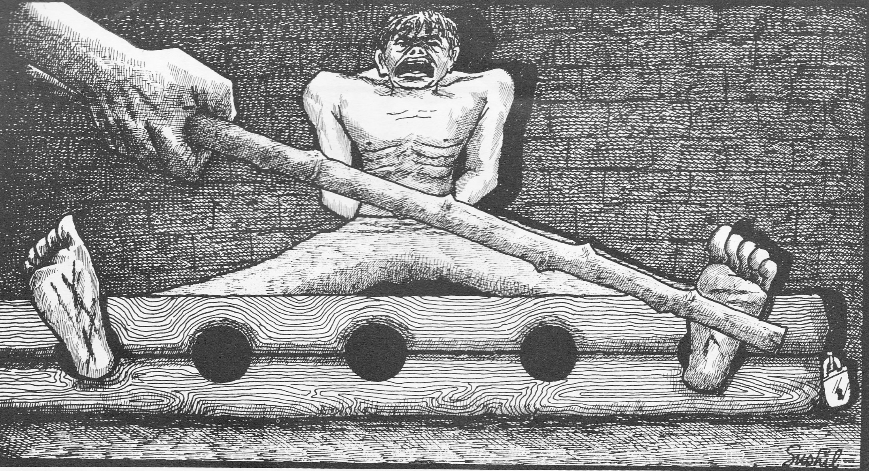
Example: Falanga
Notes:
Source: CVICT (Centre for Victims of Torture Nepal)

Slide 4
Example: Falanga
Several factors lead to damage, possibly including pressure building up in the foot tissue during swelling damaging structures (compartment syndrome)1.
In many countries, victims are forced to walk on the injured feet, or even on broken glass or nails, causing additional damage and pain.
Immediate effect and diagnosis: The immediate effect is severe pain and swelling of the foot, and discolouration. The diagnosis can be based on the charateristic clinical presentation, structural damage can in addition be assessed by Ultrasound (sonography) , MRI and X-ray. Neurological examination can identify damage to nerves. Depending on the instruments used, the skin can also break, and infection of injuries can result.
Notes:
See also the following references (for more sources to use, see following slides). The relative role of compartment syndrome has been the subject of discussion.
Amris K, Torp-Pedersen S, Rasmussen OV. Long-term consequences of falanga torture--what do we know and what do we need to know? Torture. 2009;19(1):33–40. for a discussion.
Edston E. The epidemiology of falanga–incidence among Swedish asylum seekers. Torture. 2009;19(1):27–32.
4

Slide 5
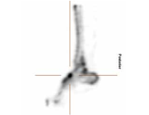
Example: Falanga
Long term impact and diagnosis:
Chronic pain especially in the feet and lower legs. Frequently patients also suffer from lower back pain (include in assessment).
Diagnostical considerations: X-ray, MRI and Bone scintigraphy can (but must not) show long term effects, ultrasound imaging (sonography) can demonstrate tissue damage, neurological examination (loss of sensation or more rarely function). Observe gait for compensatory gait patterns.
Notes:
Savnik A, Amris K, R&#x000F8;gind H, Prip K, Danneskiold-Sams&#x000F8;e B, Bojsen-M&#x000F8;ller F, et al. MRI of the plantar structures of the foot after falanga torture. European Radiology. 2000 Sep 20;10(10):1655–9.
Bro-Rasmussen F, Rasmussen OV. [Falanga torture. Are the sequelae of falanga torture due to the closed compartment syndrome in the feet and is this a common clinical picture?]. Ugeskr. Laeg. 1978 Dec 18;140(51):3197–202. Altun G, Durmus-Altun G. Confirmation of alleged falanga torture by bone scintigraphy—Case report. Int J Legal Med. 2003 Dec 1;117(6):365–6.
5

Slide 6
C. The physical examination
Skin
“Falanga” may leave contusions in the arch of the feet and swelling of the feet extending from the arch to the medial aspects of the feet and ankles 1.
Additional injuries such as scars can result if victims are forced to walk on stones or glass sherds after falanga.
Notes:
For an excellent overview see: Lis Danielsen, Ole Vedel Rasmussen: Dermatological findings after alleged torture, TORTURE Volume 16, Number 2, 2006.

Slide 7
Example: Falanga
Further considerations:
Quantitative sensory testing (QST) can be performed, if available.
Treatment can be difficult, impairment and suffering are most commonly long term and severe, which should be considered for recompensation and treatment cost calculation.
Notes:
Amris K, Torp-Pedersen S, Rasmussen OV. Long-term consequences of falanga torture--what do we know and what do we need to know? Torture. 2009;19(1):33–40.
Prip K, Persson AL. Clinical findings in men with chronic pain after falanga torture. Clin J Pain. 2008 Feb;24(2):135–41.
Edston E. The epidemiology of falanga–incidence among Swedish asylum seekers. Torture. 2009;19(1):27–32.
7

