Slide 1
Physical Evidence of Torture
Author: Prof. Thomas Wenzel
Medical University of Vienna, Austria
Notes:
1

Slide 2
A. Interview Structure
Physical evidence of torture

Slide 3
A. Interview Structure
General strategy: objective, not (re)traumatising, respectful, obtain informed consent, confidentiality issues need to be adressed
Give - clear information - enough time, especially if the client is distressed, - breaks if requested or necessary
(see also general interview and psychological evidence chapters, module on stress in interviews !)

Slide 4
B. Medical History
Physical evidence of torture

Slide 5
B. Medical History
Disorders and injuries before torture or from earlier torture
Torture – forms , duration, instruments
Intensity, frequency, duration, complaints, treatment received, impairment
Acute symptoms
Prior history
Torture
Chronic/ long term symptoms

Slide 6
C. The physical examination
Physical evidence of torture

Slide 7
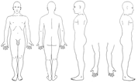
C. The physical examination
Will usually be performed after taking the medical history.
Refer to earlier chapters for preparing examination setting and sensitive interaction with the client.
In prisons, best possible use should be made of available resources, including the body diagrams (see IP annex) and cameras, if permissible.

Slide 8
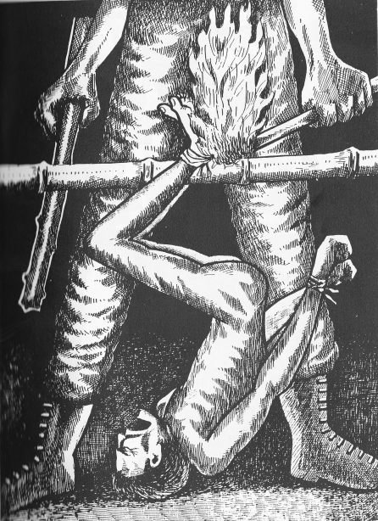
C. The physical examination
Skin
Pictures are of special importance – see separate chapters and modules
Notes:
Source: CVICT (Centre for Victims of Torture Nepal)

Slide 9
C. The physical examination
Skin
In many countries, efforts are taken to avoid obvious injuries by using „low trace“ torture techniques.
Still, the skin as outer layer“ of the body reflects most of the injuries caused by torture.
All possible traces must be documented and correlated with reported (or possibly not yet reported) torture.
Notes:
For an excellent overview see: Lis Danielsen, Ole Vedel Rasmussen: Dermatological findings after alleged torture, TORTURE, Volume 16, Number 2, 2006 (free full text available).

Slide 10
C. The physical examination
Skin
An „as good as possible“ photo documentation is a key element in the documentation of injuries, especially as traces such as haematomas (blunt injury based discolorations) vanish quickly with time.
If no proper equipment is available, a simple photograph or even a drawing is better then no documentation.

Slide 11
C. The physical examination
Skin
An „as good as possible“ photo documentation is a key element in the documentation of injuries, especially as traces such as haematomas (blunt injury based discolorations) vanish quickly with time.
If no proper equipment is available, a simple photograph or even a drwaing is better then no documentation.
A special ARTIP module therefore deals with strategies to achieve better pictures.

Slide 12
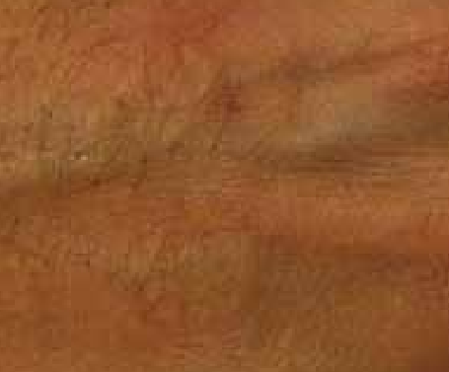
C. The physical examination
Skin
Common scars result from burning- frequently with cigarettes, - from beatings if the skin is damaged, and from cutting with knifes, glas shards or similar instruments.
Circular scar from torture with cigarettes, not recent.

Slide 13
C. The physical examination
Skin: Describe:
1) Localisation (use IP body diagram) symmetrical,
asymmetrical
2) Shape: round, oval, linear, etc.
3) Size: use ruler
4) Colour
5) Surface: scaly, crusty, ulcerative, bullous, necrotic
6) Periphery: regular or irregular, zone in the periphery
7) Demarcation: sharply, poorly
8) Level in relation to surrounding skin:
atrophic, hypertrophic, plane
Notes:
Based on Lis Danielsen, Ole Vedel Rasmussen: Dermatological findings after alleged torture, TORTURE, Volume 16, Number 2, 2006 (free full text available).

Slide 14
C. The physical examination
Skin
“Falanga”, (beatings to the soles of the feet) may leave contusions in the arch of the feet and swelling of the feet extending from the arch to the medial aspects of the feet and ankles 1.
Additional injuries such as scars can result if victims are forced to walk on stones or glass sherds after falanga. See also advanced module „Falanga“
Notes:
For an excellent overview see: Lis Danielsen, Ole Vedel Rasmussen: Dermatological findings after alleged torture, TORTURE, Volume 16, Number 2, 2006 (free full text available).

Slide 15
C. The physical examination
Face I
Eyes Use expert referal if required. CT, MRI and high-resolution ultrasound (sonography) might be required.
Ears
Example: „telephono“ (slaps to the ear) leading to tympanic membrane rupture. Laboratory tests, CT, MRI might be required.
Nose Fractures common. X-ray or CT (especially when rhinorhea is observed), MRI might be required
Notes:
CT (scan) stands for Computed Tomography scan. It is also known as a CAT (Computer Axial Tomography) scan and is commonly available. Magnetic resonance imaging (MRI), nuclear magnetic resonance imaging (NMRI), or magnetic resonance tomography (MRT) is a more complex procedure that is not always available. Especially in older MRI equipment, the patient has to tolerate a narrow, close and noisy space, which might require preparation or special consideration especially in torture survivors.
For further anatomic details, refer to standard textbooks of anatomy (see for example http://www.innerbody.com/anatomy)

Slide 16
C. The physical examination
Face II
Jaw, oropharynx and neck Mandibular fractures/ dislocation, temporomandibular joint syndrom common. Crepitation of hyoid bone, laryngeal cartriledge. Electricity traces/burns.
Oral cavity and teeth
General status, Broken/extracted/loosened teeth, possible injuries from eletricity (burns, bitten tongue or lips). X-ray, CT, MRI might be required
Notes:
Oropharynx: Oropharynx (the oral part of the pharynx) reaches from the Uvula to the level of the hyoid bone.
Especially the examination of the mouth and oral cavity can trigger traumatic memories of sexual or other abuse- perform with care !
Electricity is frequently used in the oral cavity because of high sensitivity of pain and as traces are less readily seen.

Slide 17
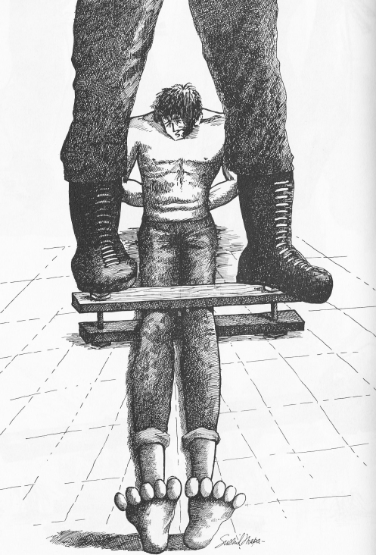
C. The physical examination
Musculosceletal system
Photographic documentation
Physical examination including neurological examination
X-ray
Ultrasound (sonography)
CT/MRI joints
Bone scintigraphy
Notes:
Source: CVICT (Centre for Victims of Torture Nepal)

Slide 18
C. The physical examination
Chest and abdomen
General condition, haematomas, lacerations and internal damage (kidney !). X-ray, CCT, MRI ultrasound or radioscintigraphy might be required.
Musculosceletal system
Include pain in rest and movement, distention. X-ray, CCT, MRI, radioscintigraphy might be required. Consider osteomyelitis, denervated muscles, chronic compartment syndrome – MRI.
Genito-urinary system
Cave: sexual trauma. Ultrasound (sonogpahy) might be required.
Notes:
Kidney damage after (acutely life threatening) damage to muscle cells releasing myoglobine from blood cells (Rhabdomyolysis) or through direct physical impact are common but frequently overlooked. Beatings in the kidney area are frequently used as they are extremely painfull.
See
Malik GH. Rhabdomyolysis and myoglobin-induced acute renal failure. Saudi Journal of Kidney Diseases and Transplantation. 1998;9(3):273.
Lameire N, Vermeersch E. Nephrological and moral aspects of physical torture. Nephrology Dialysis Transplantation. 1995;10(2):160–1.

Slide 19
C. The physical examination
Central and peripheral nervous system
Special issues: Brachial Plexopathy (asymetrical hand strength, wrist drop, arm weakness). Check for Radiculopathy.
CT, MRI, EEG and Nerve Conduction Velocity (NCV) tests might be required.

Slide 20
C. The physical examination
Central and peripheral nervous system
Blunt brain injury (due to beatings or fall) and intracerebral bleeding are common and frequently overlooked problems that can challenge assessment.
Especially intracerebral bleeding is life threatening, must be recognised and treated immediately. Impaired consciousness, dizziness and vomiting can be first signs and might require fast action.

Slide 21
C. The physical examination
Central and peripheral nervous system
Traumatic brain injury – even as mild traumatic brain injury (TBI) - can lead to a number of long term and chronic problems such as impaired sleep, memory problems and irritability (postconcussional syndrome (PCS)).
Symptoms can overlap with, but also „mimick“ posttraumatic stress disorder as the most common psychological reaction to torture.
Notes:
See also Mollica RF, Henderson DC, Tor S. Psychiatric effects of traumatic brain injury events in Cambodian survivors of mass violence. BJP. 2002 Jan 10;181(4):339–47,
and http://concussion.buffalo.edu/management%20of%20concussion%20and%20post%20concussion%20syndrome.pdf
Magnetic resonance imaging (MRI), nuclear magnetic resonance imaging (NMRI), or magnetic resonance tomography (MRT) is a more complex procedure that is not always available. Especially in older MRI equipment, the patient has to tolerate a narrow, close and noisy space, which might require preparation or special consideration especially in torture survivors.

Slide 22
C. The physical examination
Central and peripheral nervous system
Diagnosis can be difficult and can require neuropsychological testing and a special form of MRI imaging in „blunt“ injury without obvious intracerebral bleeding.
A negative finding in this procedures cannot exclude postconcussional syndrome (PCS).
Notes:
See also Mollica RF, Henderson DC, Tor S. Psychiatric effects of traumatic brain injury events in Cambodian survivors of mass violence. BJP. 2002 Jan 10;181(4):339–47,
Boake C, McCauley SR, Levin HS, Pedroza C, Contant CF, Song JX, et al. Diagnostic Criteria for Postconcussional Syndrome After Mild to Moderate Traumatic Brain Injury. J Neuropsychiatry Clin Neurosci. 2005 Aug 1;17(3):350–6.
and http://concussion.buffalo.edu/management%20of%20concussion%20and%20post%20concussion%20syndrome.pdf
Magnetic resonance imaging (MRI), nuclear magnetic resonance imaging (NMRI), or magnetic resonance tomography (MRT) is a more complex procedure that is not always available. Especially in older MRI equipment, the patient has to tolerate a narrow, close and noisy space, which might require preparation or special consideration especially in torture survivors.

Slide 23
D. Examination and Evaluation following specific forms of torture
In the report, the following qualifications are commonly used:
Not consistent with … (could not have been caused by..)
Consistent with …(unspecific, could be caused by ..or other factors)
Highly consistent with … (few other possibilities)
Typical for …(usually found after …,other causes possible)
Diagnostic of .. (only can be caused by…).

Slide 24
D. Examination and Evaluation following specific forms of torture
Note: qualifications or required phrasing might differ depending on on forensic country standards and legislation. The Istanbul Protocol offers an example, not a binding standard.

Slide 25
D. Examination and Evaluation following specific forms of torture
Overall consistency (not consistency between specific torture technique or trauma and specific injuries) is, (if at all depending on forensic country standards) considered in the final report.
For details: see a) advanced modules, b) Atlas of Torture and c) the IP.

Slide 26
E. Specialized diagnostic tests
Physical evidence of torture

Slide 27
E. Specialized diagnostic tests
Special tests might be required based on the setting (availability, probable injuries, aim and use of results (legal proceedings, diagnostical consideration, therapy). Need should be balanced with stress to the client and side effects.
They should be mentioned in the report as to be advisable but not performed if indicated and not immediately available.
A negative finding must not exclude torture.
See IP Annex and module pitfalls

